Slide 1

Kirill Belyaev and Indrakshi Ray Computer Science Department Colorado State University Fort Collins, CO, USA
Towards Access Control
for Isolated Applications
SECRYPT 2016, Lisbon, Portugal

Slide 2
Introduction Growing trends
Modern single machine instance can deploy large number of application and data services
UNIX based OS is a good candidate
Services can be deployed within Isolated Runtime Environments (IRE)
IRE can have all the necessary libraries for service deployment

Slide 3
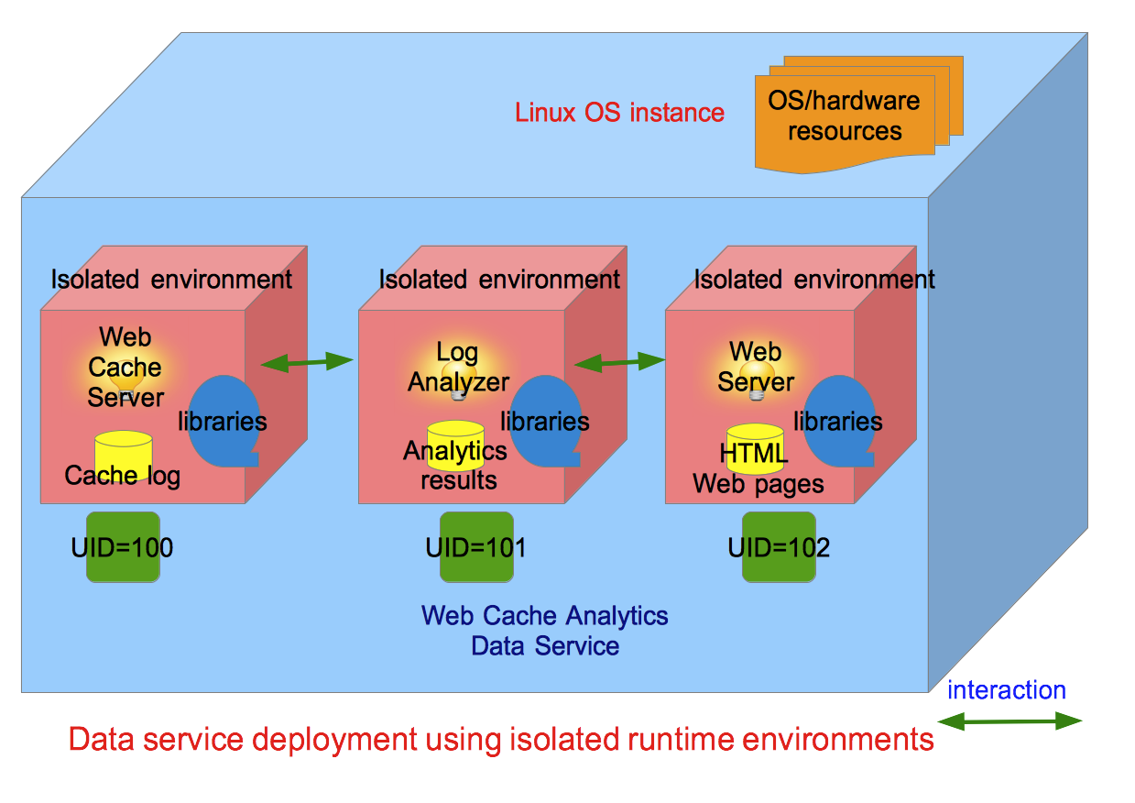
Introduction Sample deployment (1)
Single data service can be partitioned into several components

Slide 4
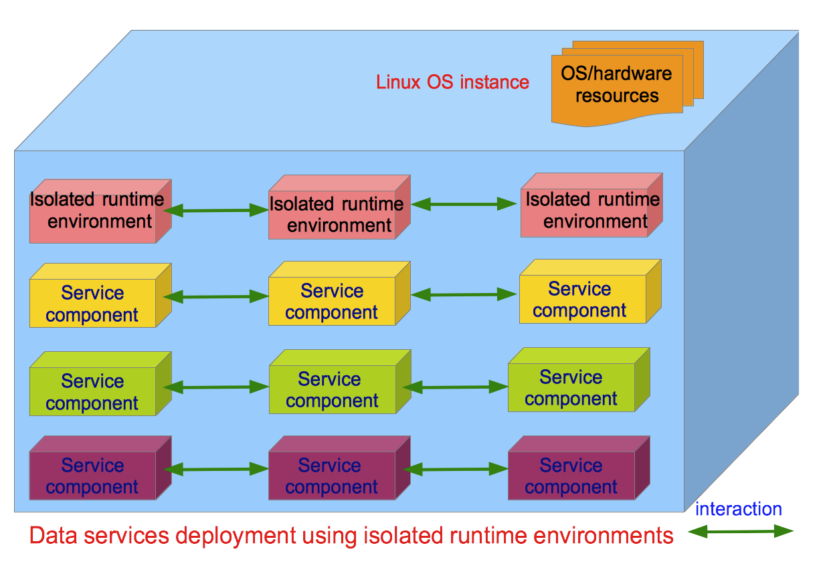
Introduction Sample deployment (2)
Single OS node can host multiple multi-component data services

Slide 5
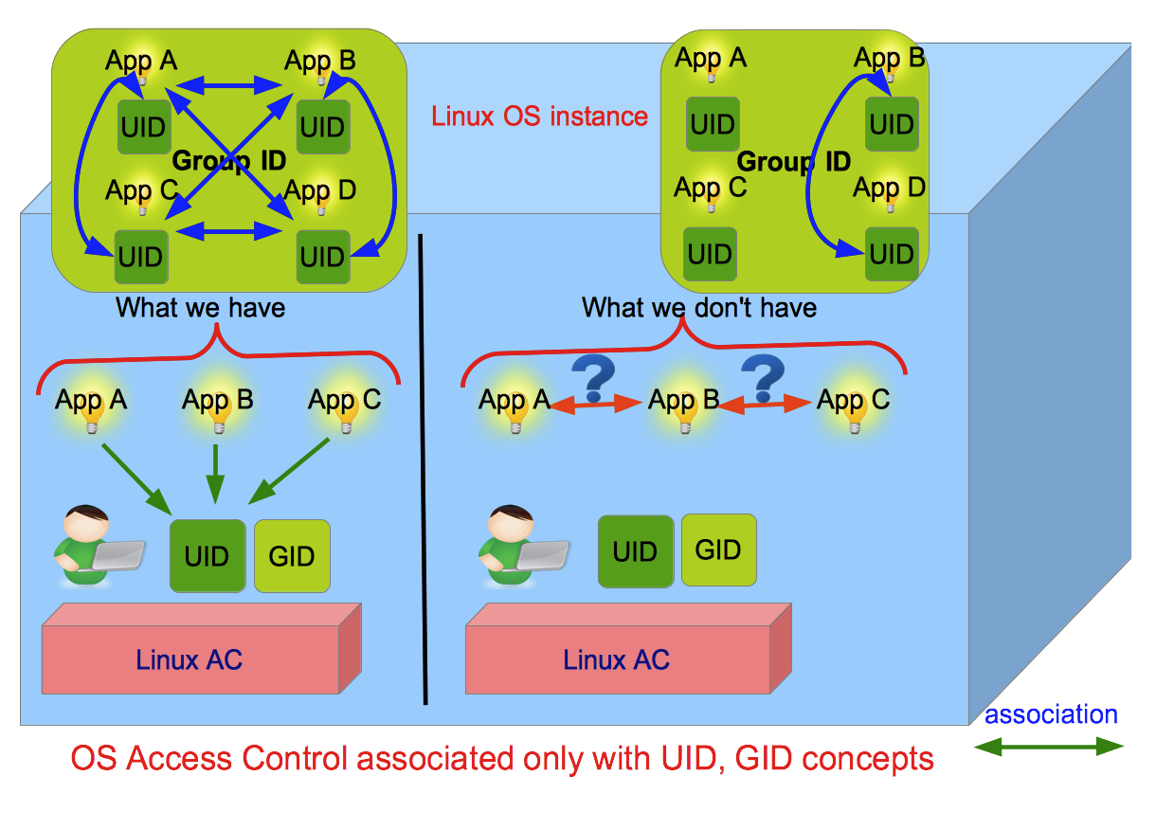
Problem Limitations of OS Access Control
Linux OS has no concept of application-level Access Control

Slide 6
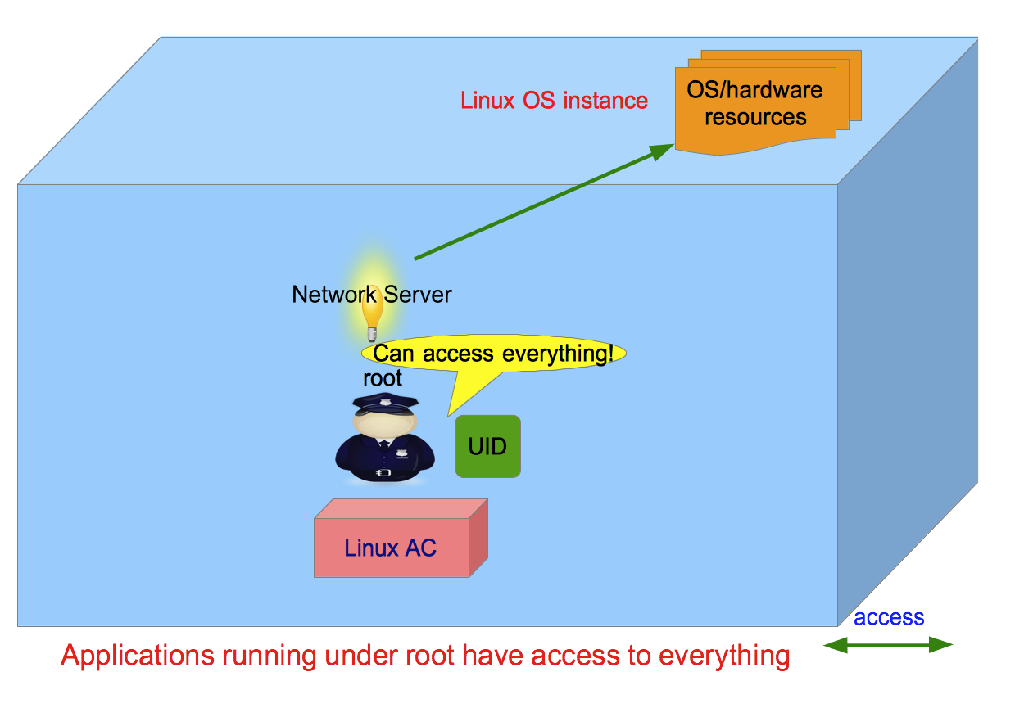
Problem Privilege escalation
Applications deployed with super-user privileges make them not bound to normal Access Control rules

Slide 7
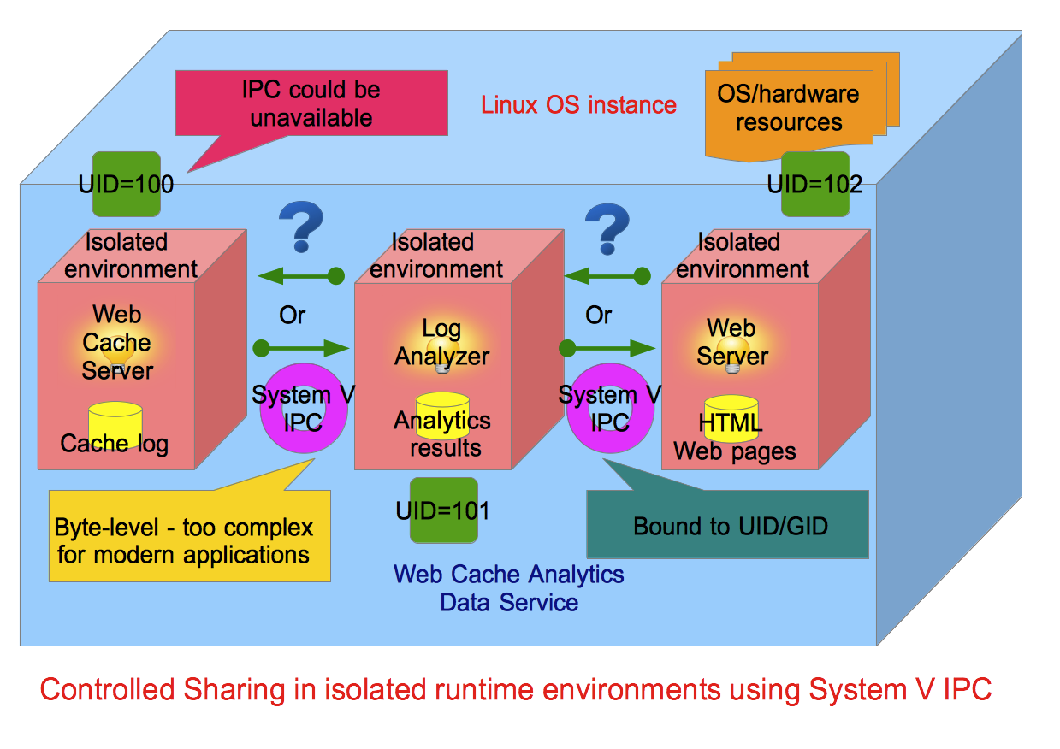
Problem Limitations of UNIX IPC
UNIX System V Inter-Process Communication (IPC) does not offer regulated way of inter-application interaction

Slide 8
Motivation
How to provide Access Control (AC) at the granularity of individual applications?
How to confine applications with minimum privileges without running them with super user privileges?
How to enable controlled application interaction across isolated runtime environments (IREs) without reliance on conventional UNIX IPC mechanisms?
How to provide manageable user-space AC interface for a large number of data services?

Slide 9
Proposed Contributions
Develop a novel object-oriented framework for application-level AC in Linux:
Capabilities Policy Class Model – enables management and enforcement of application-level resource control
Communication Policy Class Model – enables management and enforcement of controlled inter-application interaction across isolated runtime environments
Unified framework – combines both models in a unified abstraction

Slide 10
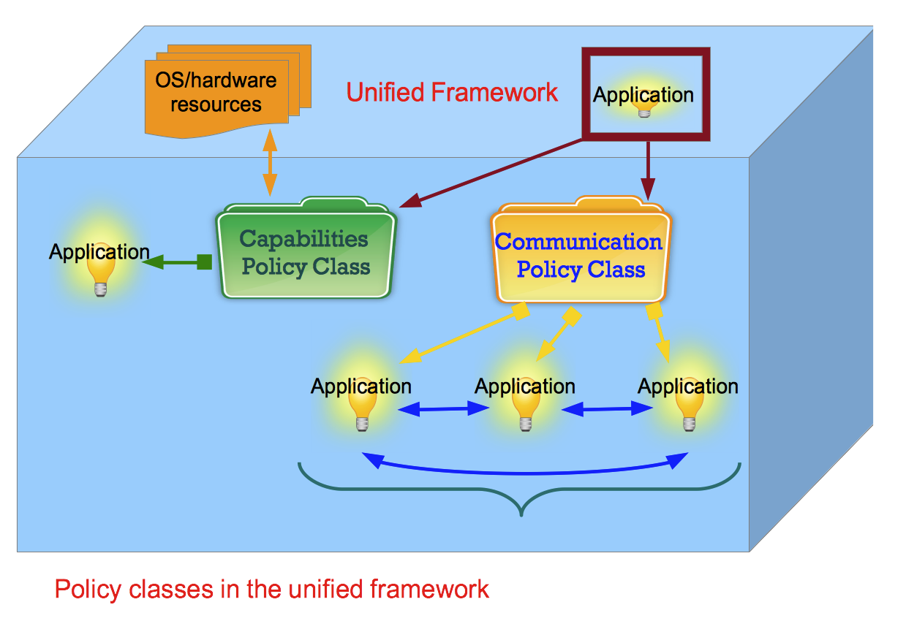
Proposed Contributions Unified Framework
2 types of policy classes to provide application-level Access Control

Slide 11
Outline
Capabilities Policy Class Model
Communication Policy Class Model
Architecture
Proposed Evaluation

Slide 12

Capabilities Policy Class Model

Slide 13
Capabilities Policy Class Model What we have
Access to OS/hardware resources is managed through kernel-space Linux (POSIX) capabilities
Capabilities split up super user privileges into independent fragments
Capabilities can manage resource control on the principle of least privilege
No user-friendly management layer to manage capabilities

Slide 14
Capabilities Policy Class Model Sample capabilities
Linux capabilities for instance include:
CAP_AUDIT_CONTROL - Enable and disable kernel auditing; change auditing filter rules; retrieve auditing status and filtering rules
CAP_DAC_OVERRIDE - Bypass file read, write, and execute permission checks
CAP_IPC_LOCK - Lock memory (mlock(2), mlockall(2), mmap(2), shmctl(2))
CAP_NET_ADMIN - Perform various network-related operations such as: interface configuration; administration of IP firewall, masquerading, and accounting; modify routing tables; bind to any address for transparent proxying; set type-of-service (TOS); clear driver statistics; set promiscuous mode; enabling multicasting; use setsockopt(2) to set the advanced socket options
CAP_SYS_BOOT - Use reboot(2) and kexec_load(2) system calls

Slide 15
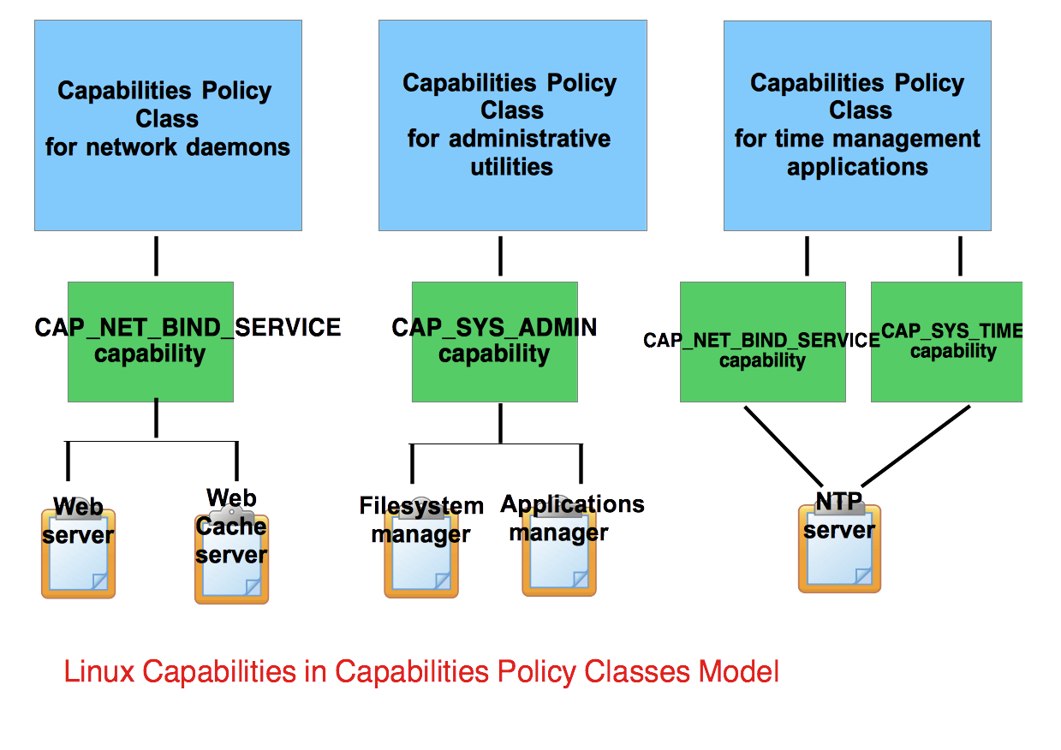
Capabilities Policy Class Model What we need
Capabilities could be grouped into various policy classes

Slide 16
Capabilities Policy Class Model Operations
The following high-level operations are proposed:
create a capabilities policy class
add/remove capabilities to/from a policy class
show capabilities in a policy class
add/remove applications to/from a policy class
show/count apps in a policy class

Slide 17
Capabilities Policy Class Model Sample usage
Here is how the model is used in practice:
SHOW_CAPABILITIES;
SHOW_POLICY_CLASSES;
CREATE_POLICY_CLASS 1 general_applications_policy_class;
ADD_POLICY_CLASS_POLICY 1 CAP_KILL;
ADD_POLICY_CLASS_POLICY 1 CAP_CHOWN;
MOVE_APP_TO_POLICY_CLASS /containers/A/apps/app-A 1;
REMOVE_POLICY_CLASS_POLICY 1 CAP_CHOWN;
SHOW_POLICY_CLASS_POLICIES 1;
SHOW_POLICY_CLASS_APPS 1;

Slide 18
Communication Policy Class Model

Slide 19
Communication Policy Class Model What we have
A group of applications (service components) may provide a single data service
A single application can be partitioned into a set of compartments
Applications in separate isolated runtime environments (IREs) need to communicate
Communication often involves:
sharing data objects
Exchanging control objects

Slide 20
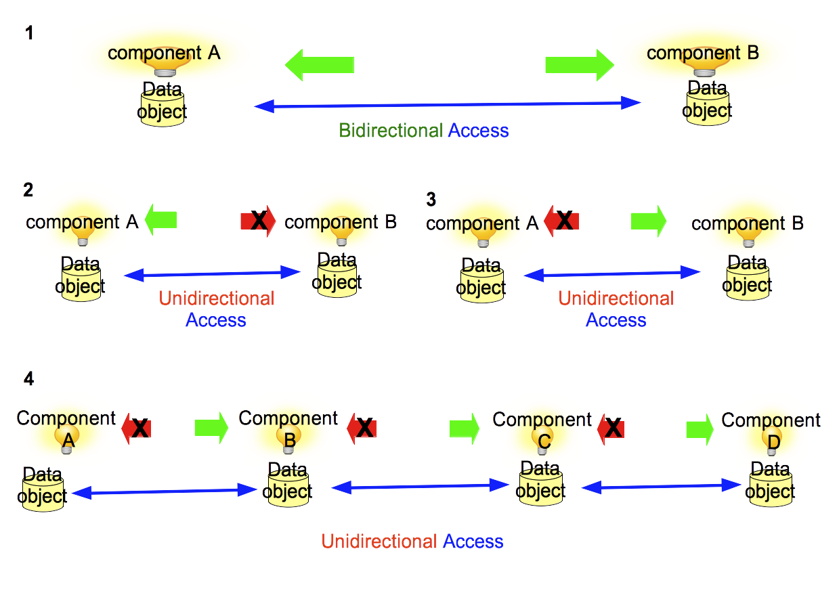
Communication Policy Class Model What we need
Provide bidirectional replication of data objects
Provide only unidirectional replication of data objects

Slide 21
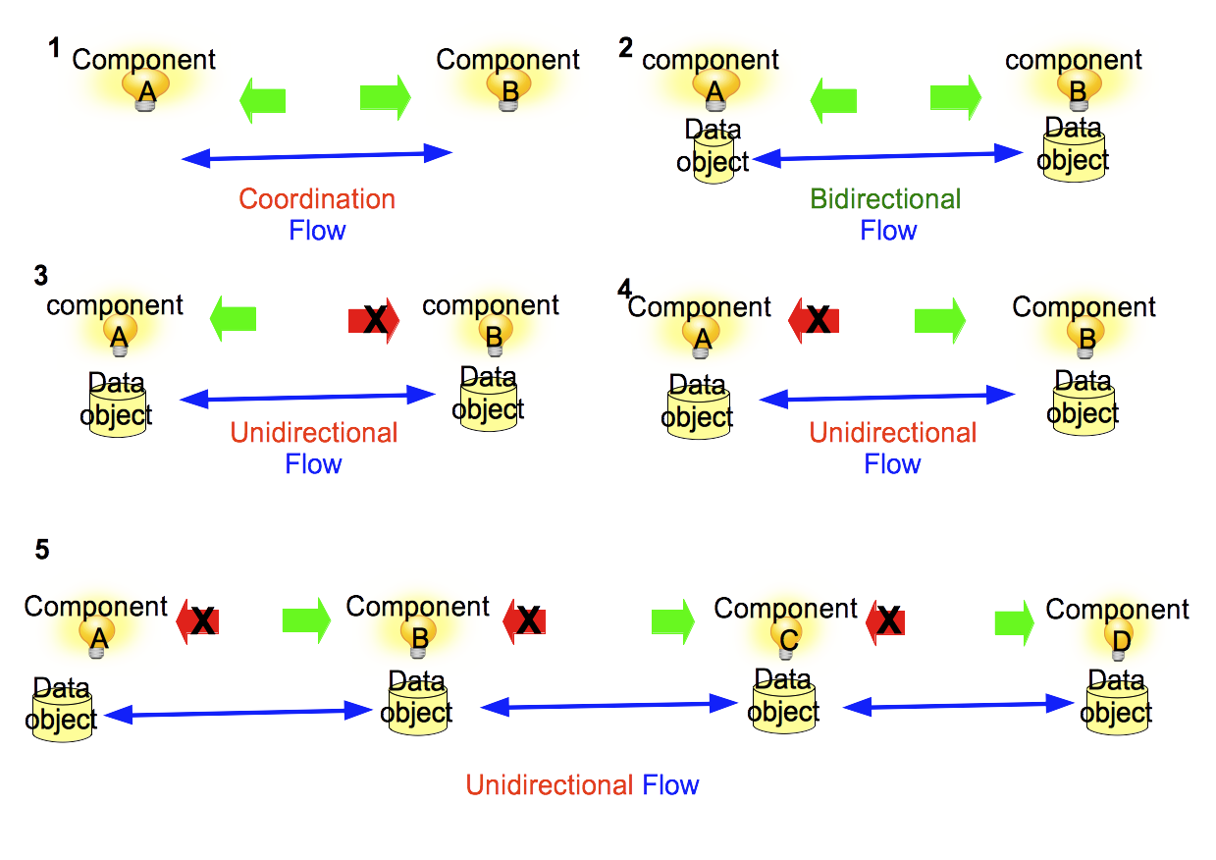
Communication Policy Class Model Types of Communication
Group of applications (service components) may:
Coordinate - exchange of coordination messages
Collaborate - share mutual data objects via replication

Slide 22
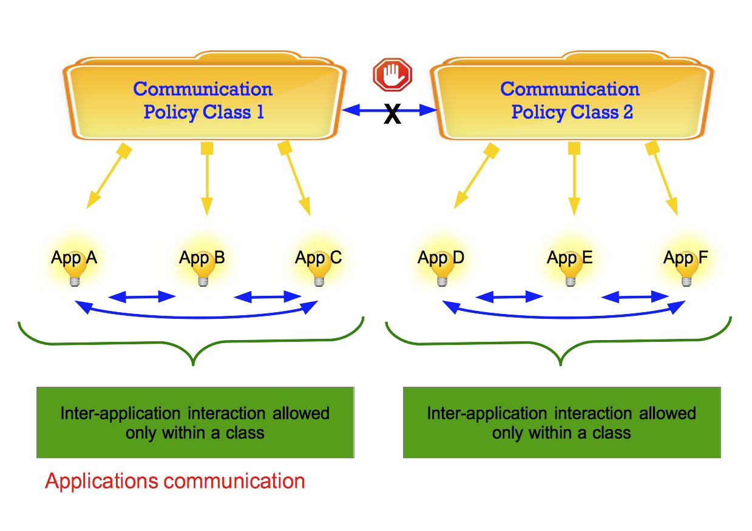
Communication Policy Class Model Properties
Group of applications can communicate only within the same class

Slide 23
Communication Policy Class Model Operations
The following high-level operations are proposed:
create a communication policy class
add/remove applications to/from a policy class
show/count apps in a policy class
add/remove associations of an app to request a replica of a data object(s) to/from a policy class
enable/disable application coordination with other application(s) in a policy class

Slide 24

Architecture

Slide 25
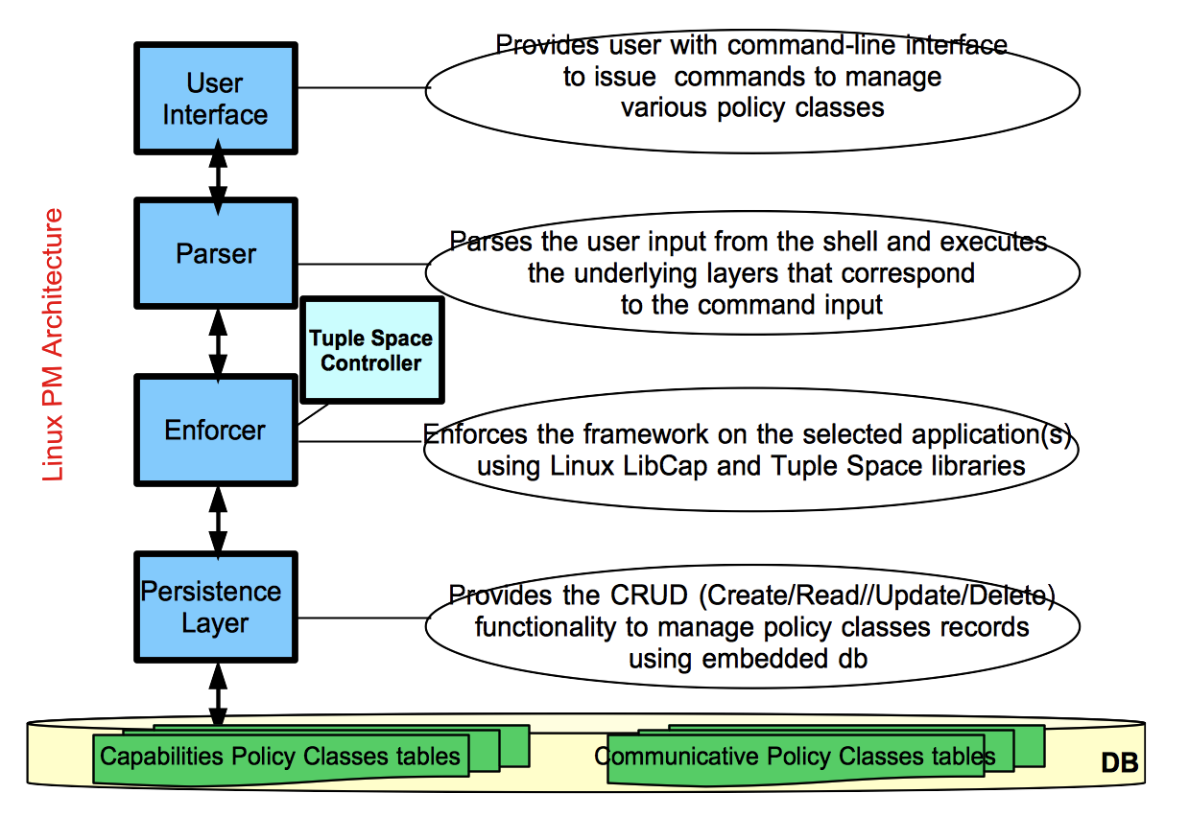
Architecture System design (1)
Unified framework proposed in the form of Linux Policy Machine

Slide 26
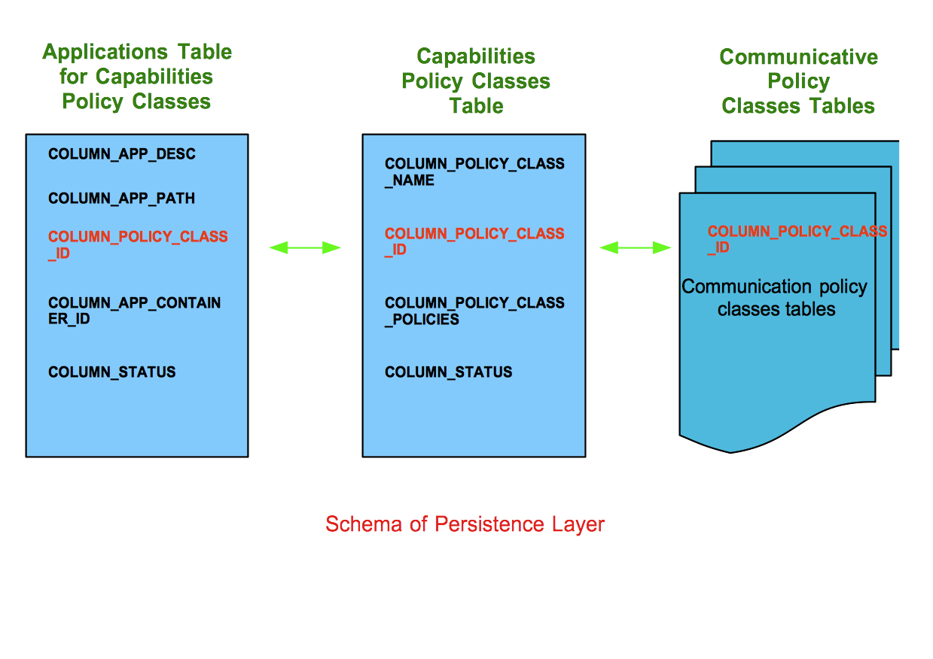
Architecture System design (2)
Unified framework stored in the embedded Sqlite database

Slide 27
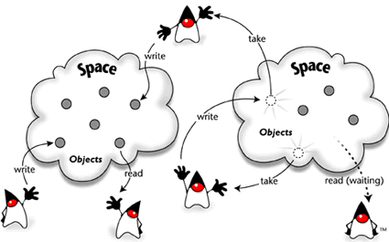
Architecture Communication design (1)
Adapt indirect communication paradigm - tuple space to enforce decoupled content-based inter-application interaction

Slide 28
Architecture Communication design (2) - Limitations
The basic model relies on a global shared RAM tuple space
Has number of issues:
Tuple collisions could happen
Wide array of possible security attacks
Overheads of memory utilization
Could be inaccessible due to access control policies
Suitable mainly for a single application with multiple threads

Slide 29
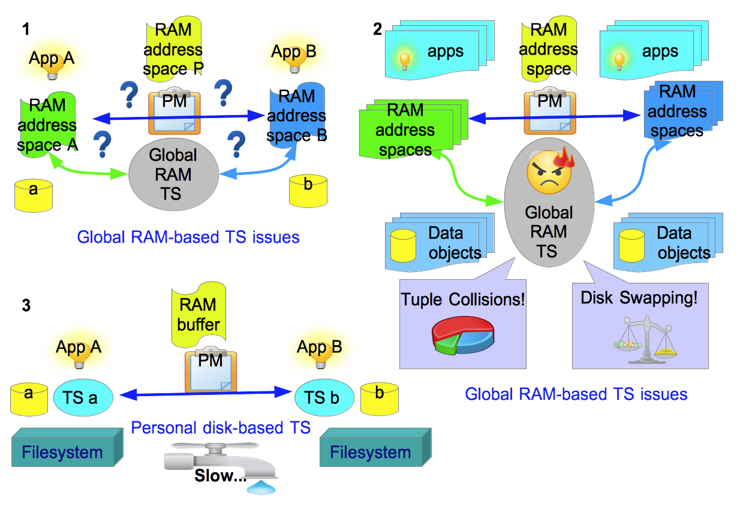
Architecture Communication design (3) - Adaptation
Personal tuple space per application
Disk/flash based implementation

Slide 30
Architecture Communication design (4) - Operations
Propose a set of tentative operations - tuple space calculus:
create tuple space
delete tuple space
read operation - returns the value of individual tuple without affecting the contents of a tuple space
append operation - adds a tuple without affecting existing tuples in a tuple space
take operation - returns a tuple while removing it from a tuple space

Slide 31
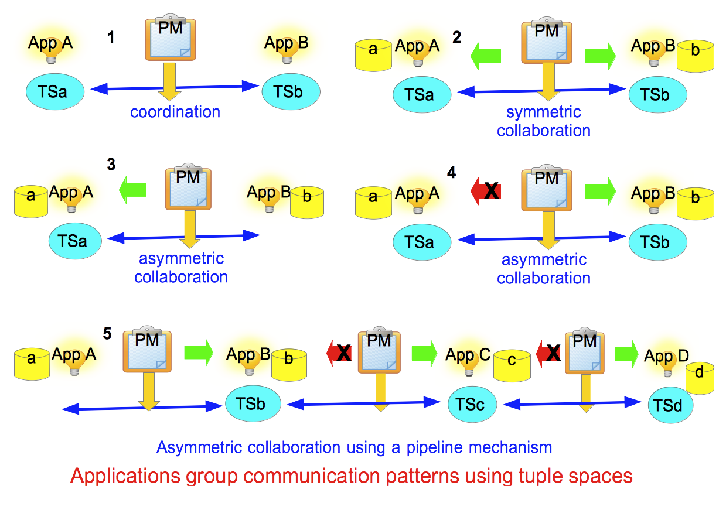
Architecture Communication design (5) - Patterns
Application allowed to perform all calculus operations
Policy Machine restricted to read and append operations

Slide 32
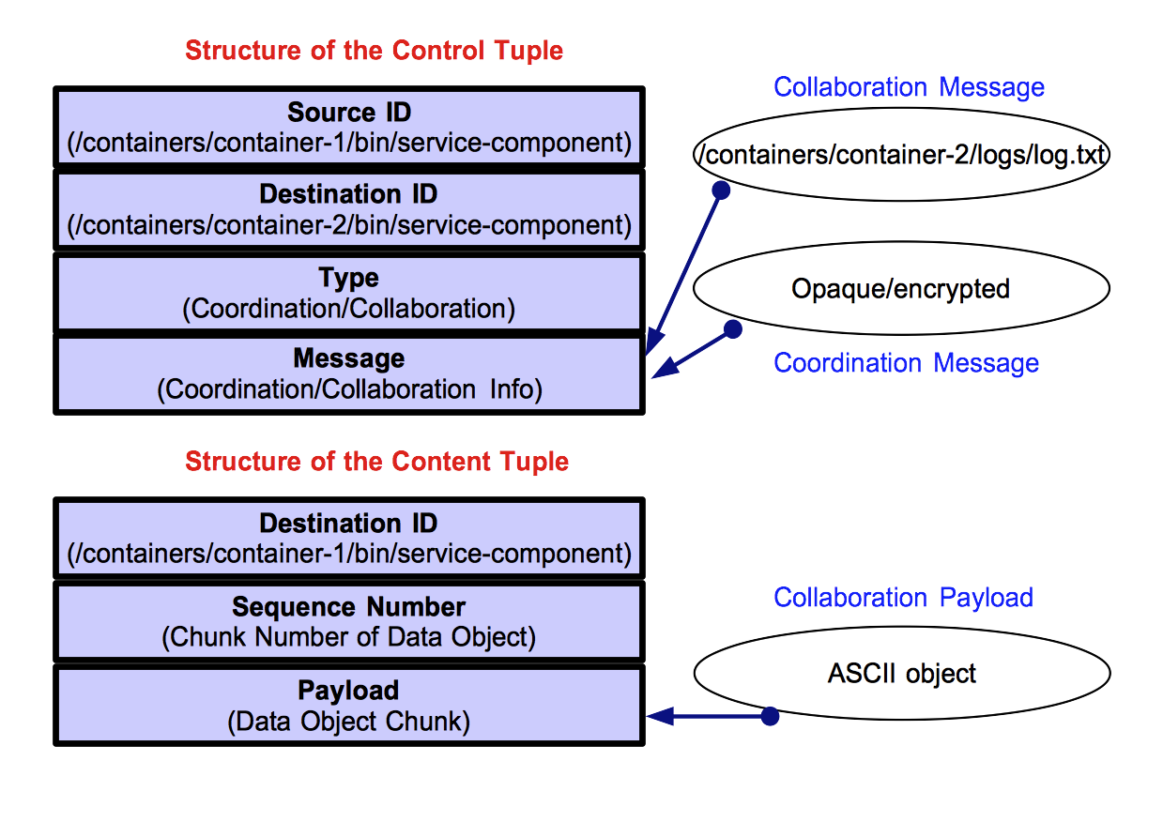
Architecture Communication design (6) – Tuple Types
Control tuples - provide the instructions about coordination or sharing
Content tuples - mechanism by which data gets shared across applications

Slide 33
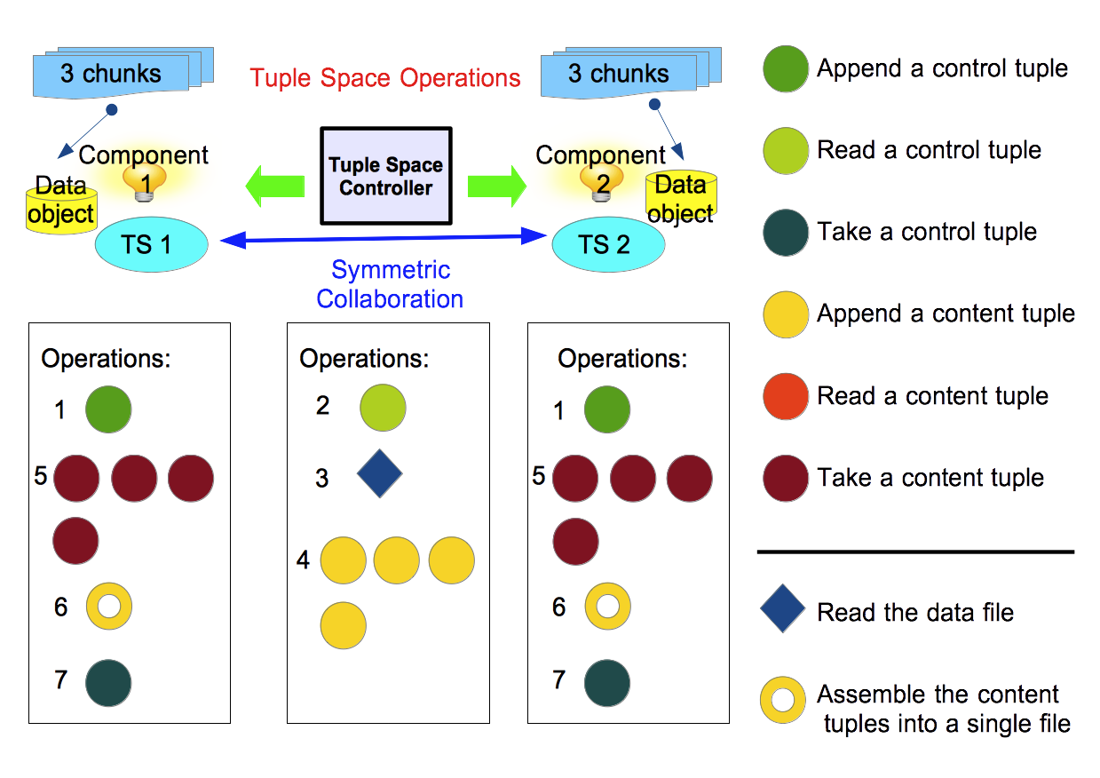
Architecture Communication design (7) – Collaborative Transaction
Policy machine periodically checks for the presence of control tuples

Slide 34
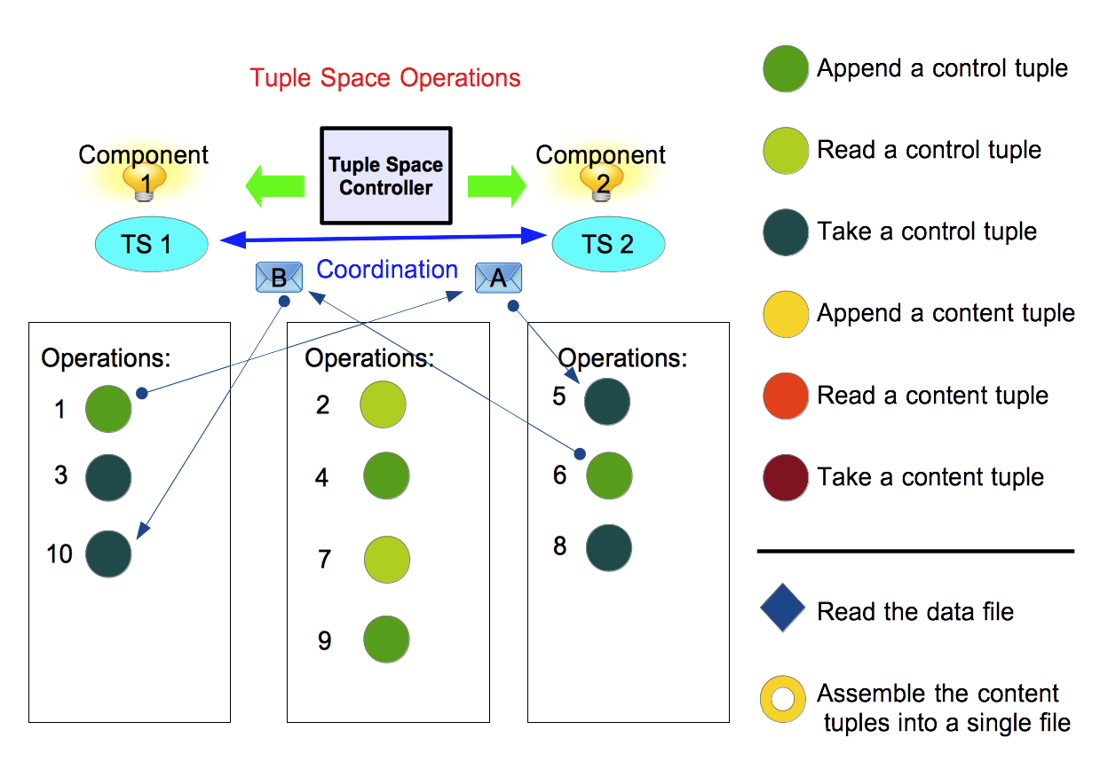
Architecture Communication design (8) – Coordinative Transaction
Policy machine periodically checks for the presence of control tuples

Slide 35
Proposed Evaluation
Capabilities policy classes do not incur performance overhead
no extra disk I/O aside from the I/O load of the base system
no additional memory utilization
Communication policy classes are resource intensive
Evaluate performance with integrated tuple space controller:
Sizes of mediated data objects | Number of communicating applications
Disk I/O utilization | Disk I/O utilization
CPU utilization | CPU utilization
RAM utilization | RAM utilization

Slide 36
Summary
Unified Framework consists of:
model of Capabilities Policy Classes – regulates Linux capabilities on a per-application granularity
model of Communication Policy Classes - regulates inter-application interaction
Enforcement of the framework is done via:
Capabilities model – Linux LibCap library
Communication model – Tuple Space Library/Controller (to be developed)
Targets deployment of decoupled multi-component data services on multi-core server instance

Slide 37
Future Work
Address the distributed deployment of unified framework
Address the problems of policy representation and validation
Investigate additional security for tuple spaces on fast persistent storage
Investigate scalability issues
Investigate the applicability for Dockers
Notes:
Secure memory-resident tuple spaces might not be necessary – rather the continuation of usage of fast persistent storage (SSD, flash memory) is more promising. Here security issues pertaining to file system operations might be investigated.
Also some encryption strategies for hiding the actual contents of control/content tuples from possible observer could be investigated – dynamic key-less encryption.
Scalability issues – related to how many concurrent tuple space transactions we can handle on a single server instance without performance degradation for deployed services

Slide 38
Sample Service Policy in XML
<?xml version="1.0" encoding="UTF-8"?> <AutomationPolicy productID=“EEZALAdapter“ version="3.2.2" xmlns="http://www.ibm.com/TSA/Policy.xsd" xmlns:xsi="http://www.w3.org/2001/XMLSchema-instance" xsi:schemaLocation="http://www.ibm.com/TSA/Policy.xsd EEZALPolicy.xsd "> <PolicyInformation> <PolicyName>Agentless adapter sample policy</PolicyName> <AutomationDomainName>AgentlessDomain</AutomationDomainName> <PolicyToken>1.0.5</PolicyToken> <PolicyAuthor>LPM</PolicyAuthor> <PolicyDescription> Agentless adapter sample policy. ------------------------------------------------------ </PolicyDescription> </PolicyInformation> ... </AutomationPolicy>

Slide 39
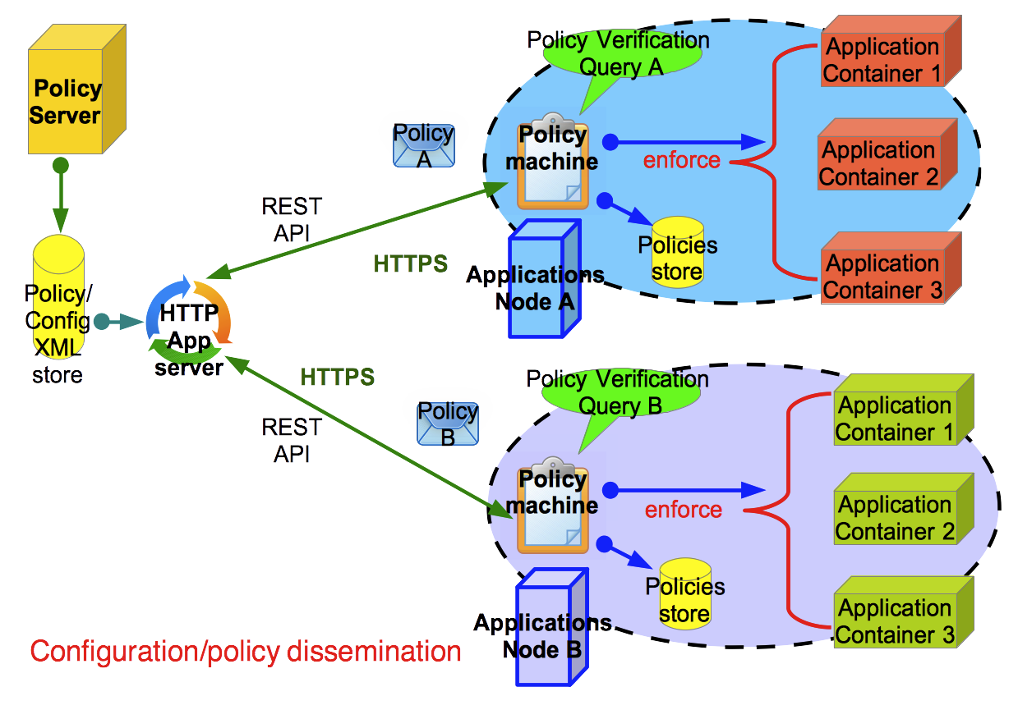
Policy orchestration mechanisms

Slide 40
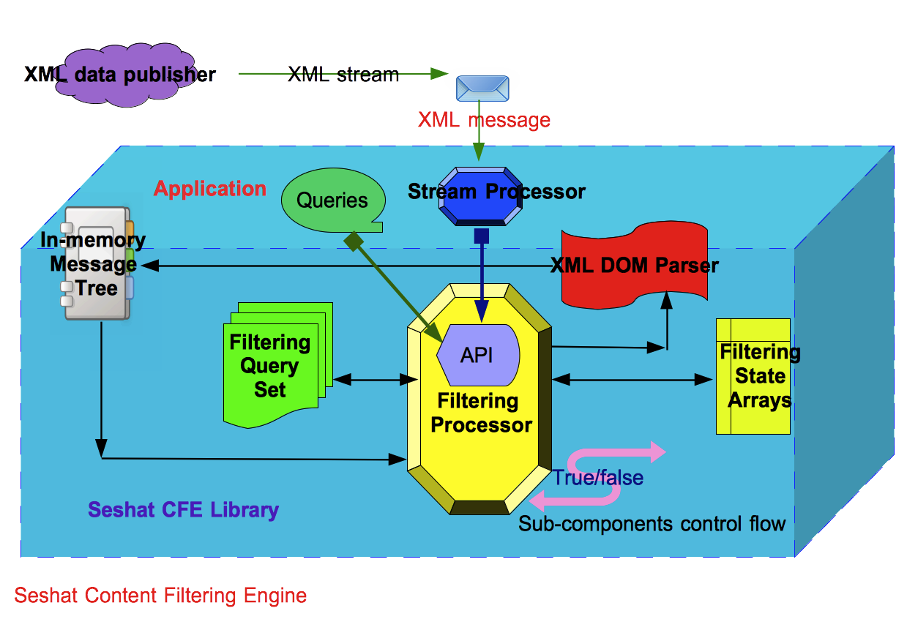
Policy validation with XML content filtering engine

Slide 41

Thank you for your attention!
Questions?

